Slide 1
UNIT 3
TRANSACTION PROCESSING

Slide 2
Transaction in DBMS
A transaction refers to a sequence of one or more operations (such as read, write, update, or delete) performed on the database as a single logical unit of work.
A transaction ensures that either all the operations are successfully executed (committed) or none of them take effect (rolled back).
Transactions are designed to maintain the integrity, consistency and reliability of the database, even in the case of system failures or concurrent access.

Slide 3
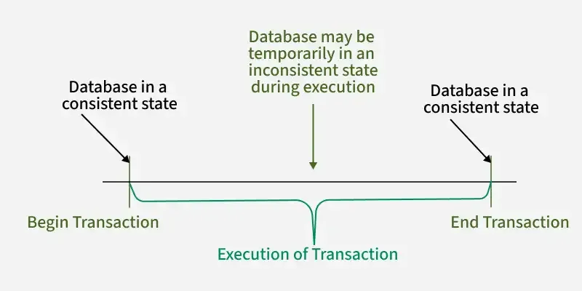

Slide 4
Transaction Steps (as a single unit):
Read: balance of Account A.
Subtract: $100 from Account A's balance.
Write: the new balance back to Account A.
Read: balance of Account B.
Add: $100 to Account B's balance.
Write: the new balance back to Account B.

Slide 5
ACID Properties
Atomicity (All or Nothing): Either all steps complete successfully, or none of them do. If the system crashes after debiting Account A but before crediting Account B, the entire transaction is rolled back, and Account A's balance is restored.
Consistency: The database moves from one valid state (e.g., $1000 in A, $500 in B) to another valid state (e.g., $900 in A, $600 in B), maintaining rules like total money in the system remaining constant.
Isolation: If another user tries to access Account A or B during this transfer, they won't see the intermediate, incomplete state (e.g., Account A's new balance before Account B is updated).
Durability: Once the transaction is successfully committed (all steps done), the changes are permanent and survive system failures.

Slide 6
E.g. transaction to transfer $50 from account A to account B: 
1. read(A)
2. A := A – 50
3. write(A)
4. read(B)
5. B := B + 50
6. write(B)

Slide 7
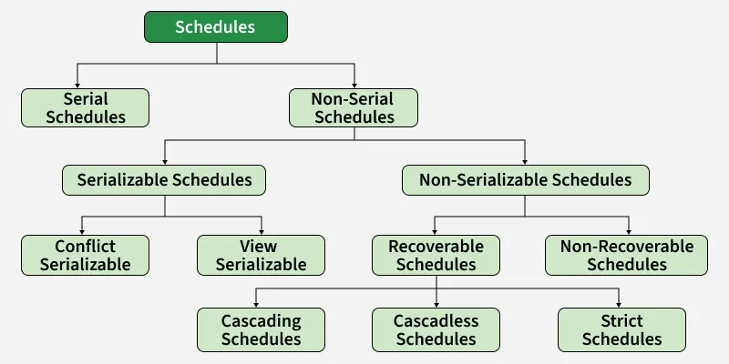
Types of Schedules in DBMS
Scheduling is the process of determining the order in which transactions are executed.
When multiple transactions run concurrently, scheduling ensures that operations are executed in a way that prevents conflicts or overlaps between them.

Slide 8
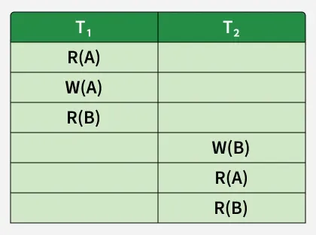
Serial Schedule:
  Only one transaction runs at a time.
  No concurrency issues.
  Simple and always consistent.
Example: Consider the following schedule involving two transactions T1 and T2 .

Slide 9
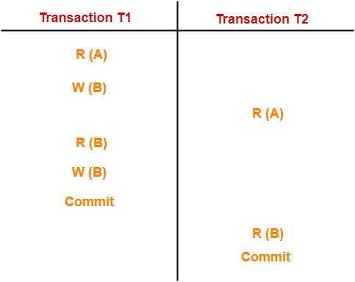
Non-Serial Schedule
Transactions execute in an interleaved manner in Non-Serial Schedule.
Allows concurrency.
Must be checked for correctness.
May or may not be serializable.

Slide 10
Serializability in DBMS-
Some non-serial schedules may lead to inconsistency of the database.
Serializability is a concept in transaction management that ensures transactions are executed in such a way that the final result is the same as if the transactions were executed one after the other (serially) rather thn concurrently.
Serializable Schedules-
If a given non-serial schedule of ‘n’ transactions is equivalent to some serial schedule of ‘n’ transactions, then it is called as a serializable schedule.

Slide 11
Characteristics-
Serializable schedules behave exactly same as serial schedules.
Thus, serializable schedules are always-
Consistent
Recoverable
Casacadeless
Strict

Slide 12
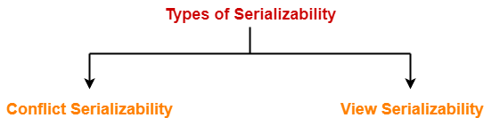
Types of Serializability-

Slide 13
Conflict Serializability-
Conflicting Operations-
Two operations are called as conflicting operations if all the following conditions hold true for them-
1.Both the operations belong to different transactions
2.Both the operations access the same data item
3.At least one of the two operations is a write operation
If a given non-serial schedule can be converted into a serial schedule by swapping its non-conflicting operations(without changing the result), then it is called as a conflict serializable schedule.

Slide 14
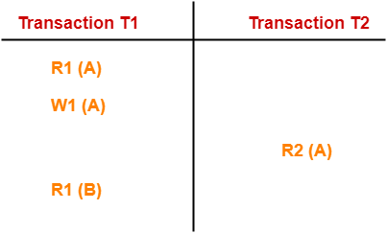
In this schedule,
W1 (A) and R2 (A) are called as conflicting operations.
This is because all the above conditions hold true for them.

Slide 15
View Serializability-
For view serialiazability we focus on the view (what data the transactions read and write) rather than conflicts.
Condition:
The transactions must read and write the same data items in the same order.
The final result must match a serial execution.

Slide 16
1.li = read(Q), lj = read(Q). li and lj don‘t conflict.
2. li = read(Q), lj = write(Q). They conflict.
3. li = write(Q), lj = read(Q). They conflict
4. li = write(Q), lj = write(Q). They conflict

Slide 17
TRANSACTION RECOVERY
Database Systems, like any other computer system, are subject to failures.
Whether it's a sudden power outage, a software bug, or a hardware crash, a Database Management System (DBMS) needs a way to get back up and running without losing data or leaving it in a corrupted state.
This process of restoring the database to a correct and consistent state is called recovery.
The main aim of recovery is to maintain "atomicity" and "durability", which are two important parts of the ACID properties:
Atomicity: A transaction should either complete fully or not at all.
Durability: Once a transaction is committed, its changes must stay in the database even if a failure occurs afterward.

Slide 18
Types of Recovery Techniques
1. Log-Based Recovery
One of the most common recovery methods in modern databases. The keeps a log file (or journal) on stable storage that records every change—insert, update, or delete—before it is applied to the database.
If a failure occurs, the DBMS reads the log to decide what to do:
Undo: Reverse changes from transactions that didn’t finish (ensuring atomicity).
Redo: Reapply changes from committed transactions (ensuring durability).

Slide 19
Shadow Paging
Shadow Paging is an alternative recovery technique that avoids the need for a log.
It works by keeping two versions of the database pages during a transaction:
current page table and a shadow page table
The shadow page table points to the original, unmodified database pages from before the transaction began. It's a "shadow" of the consistent database state.
When a transaction starts modifying data, new copies of the modified pages are created. The current page table is updated to point to these new pages while the shadow page table remains unchanged.
If the transaction commits, the current page table becomes the new shadow. If it fails, the system discards the modified pages and reverts to the shadow- no undo/redo needed.

Slide 20
Checkpointing: Making Recovery Faster
Forces all log records from memory to stable storage.
Forces all modified database pages from memory to stable storage.
Writes a special checkpoint record into the log file.
When recovery is needed, the DBMS finds the last checkpoint. It knows that any transaction that committed before the checkpoint is already permanently saved.
Therefore, it only needs to scan the log from the checkpoint onward to figure out which transactions to undo or redo, drastically speeding up the recovery time.

Slide 21
Aries Recovery Algorithm Phases
1. Analysis Phase
2.Redo Phase
3.Undo Phase
Analysis Phase:
The Analysis Phase identifies the database's state and determines which log entries need to be processed for recovery.

Slide 22
Analysis Phase:
The Analysis Phase identifies the database's state and determines which log entries need to be processed for recovery.
Example: Suppose we have a log with the following entries:
<T1, Start>
<T1, Write(A, 10)>
<T1, Commit>
<T2, Start>
<T2, Write(B, 20)>
<T2, Abort>
The system reads the log to identify active transactions (T2) and committed transactions (T1).
It also records the state of database pages that were modified by active transactions.

Slide 23
Redo Phase
The Redo Phase re-applies changes recorded in the log to ensure that all committed transactions are properly reflected in the database.
Undo Phase
The Undo Phase reverses changes made by aborted transactions, restoring the database to a consistent state by undoing any modifications from these transactions.

Slide 24
Example of Aries Recovery Algorithm in DBMS
Let's consider a more detailed scenario:
Initial State:
Page A: 0
Page B: 0
Transactions:
T1 writes A = 10 and commits.
T2 writes B = 20 and aborts.
Log Entries
<T1, Start>
<T1, Write(A, 10)>
<T1, Commit>
<T2, Start>
<T2, Write(B, 20)>
<T2, Abort>
After Crash:
Checkpoint indicates page A was modified.
Analysis Phase finds T1 committed, T2 aborted.
Redo Phase reapplies T1’s write to page A.
Undo Phase rolls back T2’s write to page B.

Slide 25
Transaction Isolation Levels in DBMS
What is Isolation Level?
As we know, to maintain consistency in a database, it follows ACID properties.
Among these four properties (Atomicity, Consistency, Isolation, and Durability)
Isolation means that a transaction should take place in a system in such a way that it is the only transaction that is accessing the resources in a database system.

Slide 26
What is an “Isolation Level”?
Database isolation defines the degree to which a transaction must be isolated from the data modifications made by any other transaction(even though in reality there can be a large number of concurrently running transactions). The overarching goal is to prevent reads and writes of temporary, aborted, or otherwise incorrect data written by concurrent transactions.
Transaction isolation level is defined by the following phenomena

Slide 27
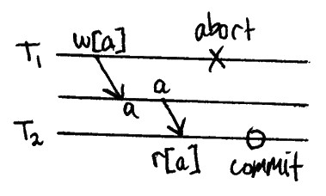
Transaction isolation level is defined by the following phenomena
A transaction reads data written by a concurrent uncommitted transaction. (uncommitted data is called “dirty.”)

Slide 28
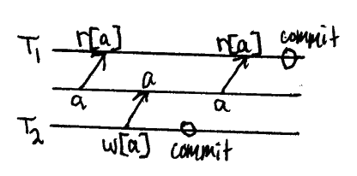
Non-Repeatable Reads
A transaction re-reads data it has previously read and finds that data has been modified by another transaction (that has been committed since the initial read).

Slide 29
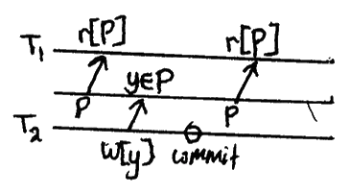
Phantom Reads
A transaction re-executes a query returning a set of rows that satisfy a search condition and finds that the set of rows satisfying the condition has changed due to another recently-committed transaction.

Slide 30
Based on these phenomena, These four isolation levels have been defined
Read Uncommitted
Read Committed
Repeatable Read
Serializable

Slide 31
The four standard isolation levels are:
1. Read Uncommitted
This is the lowest level of isolation where a transaction can see uncommitted changes made by other transactions. This can result in dirty reads, non-repeatable reads, and phantom reads.
2. Read Committed
In this isolation level, a transaction can only see changes made by other committed transactions. This eliminates dirty reads but can still result in non-repeatable reads and phantom reads.
3. Repeatable Read
This isolation level guarantees that a transaction will see the same data throughout its duration, even if other transactions commit changes to the data. However, phantom reads are still possible.
4. Serializable
This is the highest isolation level where a transaction is executed as if it were the only transaction in the system. All transactions must be executed sequentially, which ensures that there are no dirty reads, non-repeatable reads, or phantom reads.

Slide 32
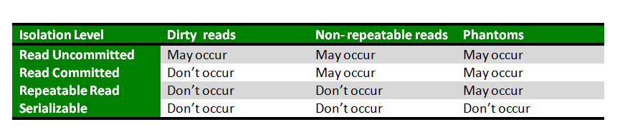

Slide 33
CONTENT BEYOND SYLLABUS
Thomas Write Rule in DBMS
Developed by: R. H. Thomas (1979)
Type: Timestamp-based concurrency control
Goal: Reduce unnecessary rollbacks while maintaining view serializability
Symbol | Meaning
TS(T) | Timestamp of transaction T
R_TS(X) | Timestamp of the last read on data item X
W_TS(X) | Timestamp of the last write on data item X

Slide 34
Write Operation Conditions in TWR
1. Abort the Transaction:
If R_TS(X) > TS(T)
A newer transaction has already read X, so writing now would violate serializability.
Action: Abort and rollback T.
2. Ignore Outdated Writes (Allow Execution Without Writing):
If W_TS(X) > TS(T)
A newer write has already updated X. Writing now is obsolete.
Action: Ignore the write; continue the transaction.
3. Execute Write Operation (Normal Execution):
If neither condition above is true
Action: Execute W_item(X) and update W_TS(X) = TS(T)

